Slide 1
Bike Price Prediction
Amos Dinh, Matthias Fast

Slide 2
Agenda
Problem formulation
Crawling for data
Filtering and cleaning the data
Loss function
Model Training
Visualization of activations (Conclusion)

Slide 3
1. Problem formulation and motivation
Suppose you can identify bicycles which are underpriced based on an image of the bicycle
You can resell the bicycle to make profit
-> Problem formulation:
„Predict offer-price in euros, given an image of a bike”

Slide 4
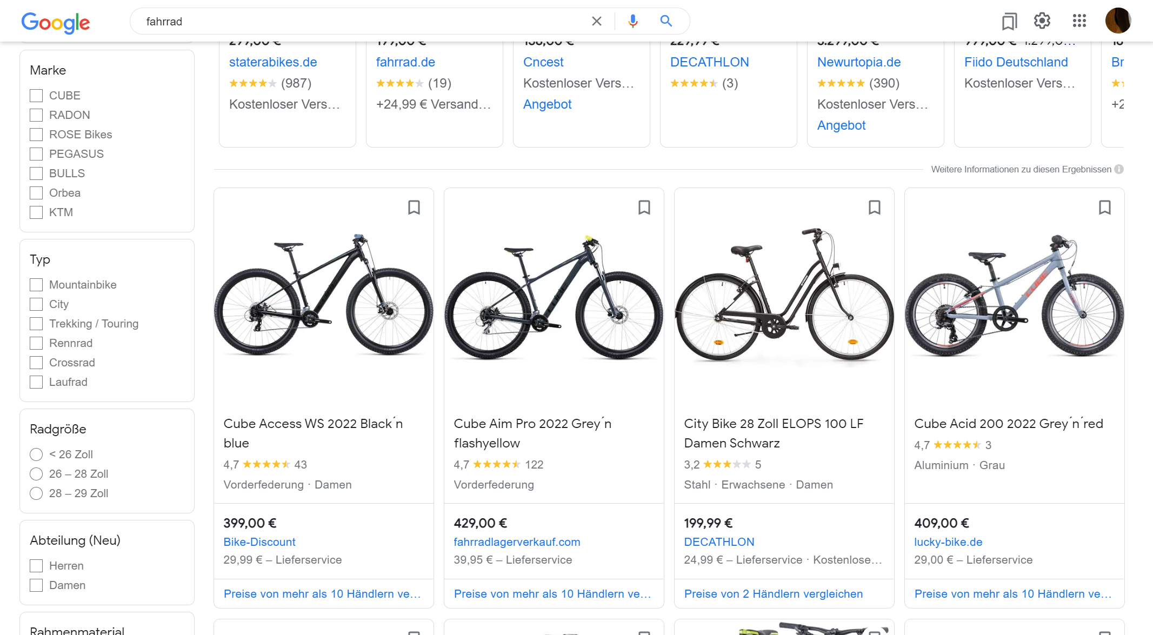
2. Crawling
„Predict offer-price in euros, given an image of a bike”
(Image, price) mapping can be consistently obtained with webscraping
scraping of bicycle-images:
High Quality:
www.fahrrad.de (1500)
www.fahrrad-xxl.de (5700)
Low Quality:
www.google.com/... &tbm=shop (52000)
~60000 Images

Slide 5
3. Filtering and Cleaning
Constraints for an image
The picture has to contain one bicycle
Reduce the amount of data needed (Narrowed-down problem formulation):
The bicycle has to face sideways
The background of the image needs to be monotonous.
-> Aim to remove deviating images

Slide 6
3. Filtering and Cleaning
3.1. Filter out non-bicycle images
3.2. Remove non-monotonous and other images
3.3. Remove duplicates
3.4. Is there bias in the images?
(3.5.) Preprocessing and mean image

Slide 7

3.1. Filter out non-bicycle images
clf. head embeddings
Chosen method:
Compute image embeddings using ResNet50 CNN (ImageNet)
filter images: label “bad samples” by hand and use their embeddings to localize similar “bad” images
Filter images with visual verification
base model embeddings

Slide 8
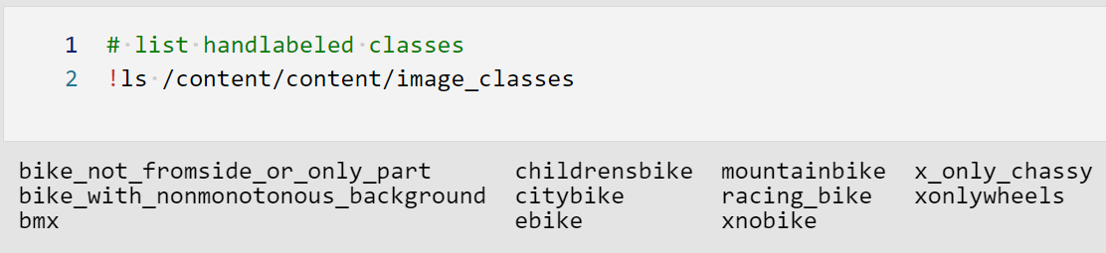
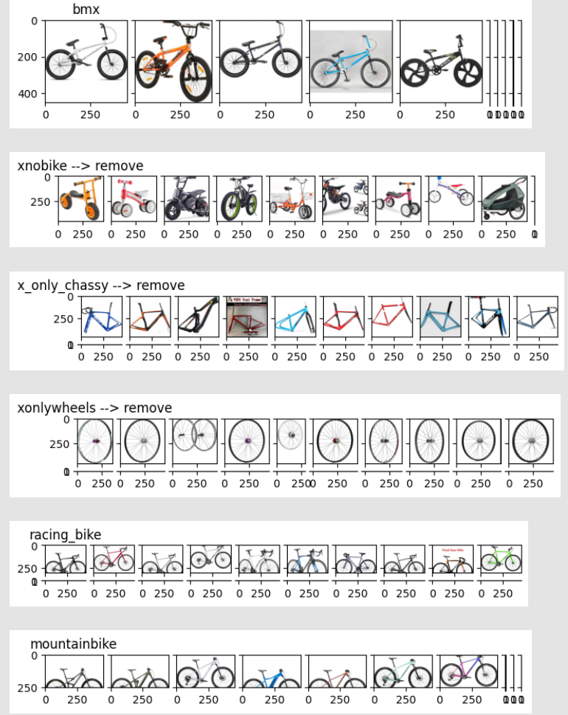
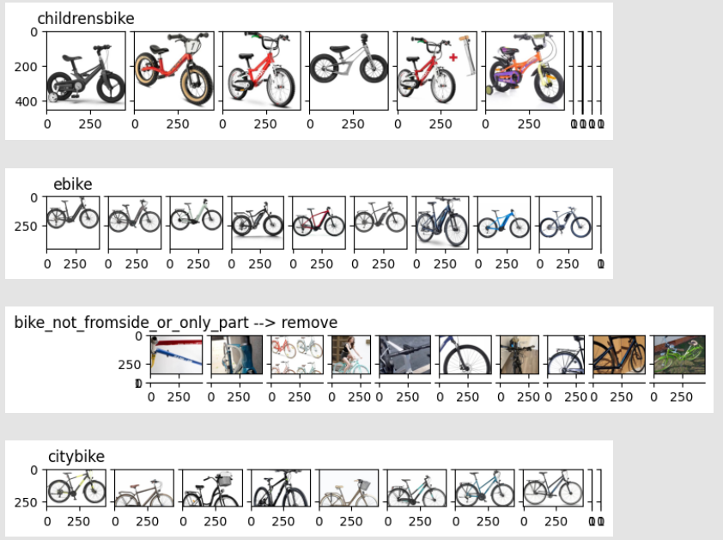
3.1. Filter out non-bicycle images

Slide 9
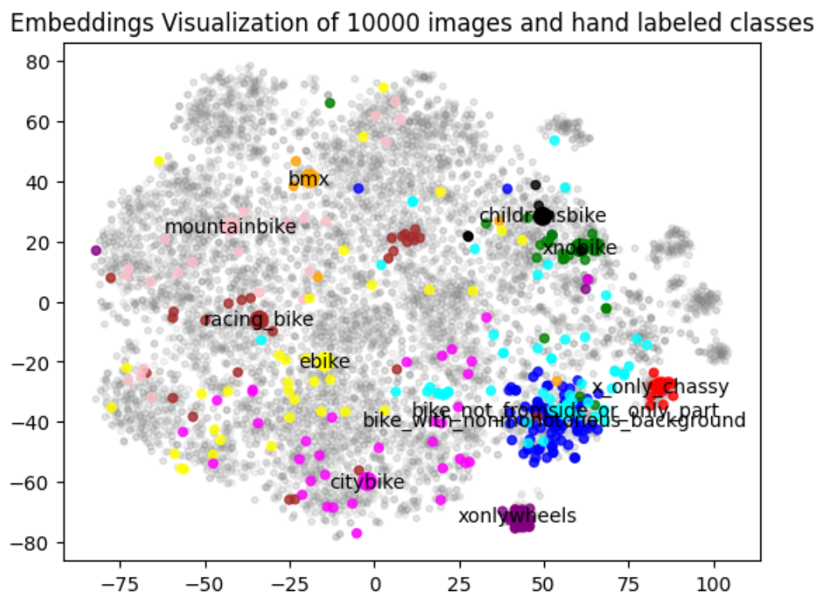
3.1. Filter out non-bicycle images
TSNE of ResNet base:
Embeddings of classes to be removed are marked red.
xnobike (green) is not well separated

Slide 10
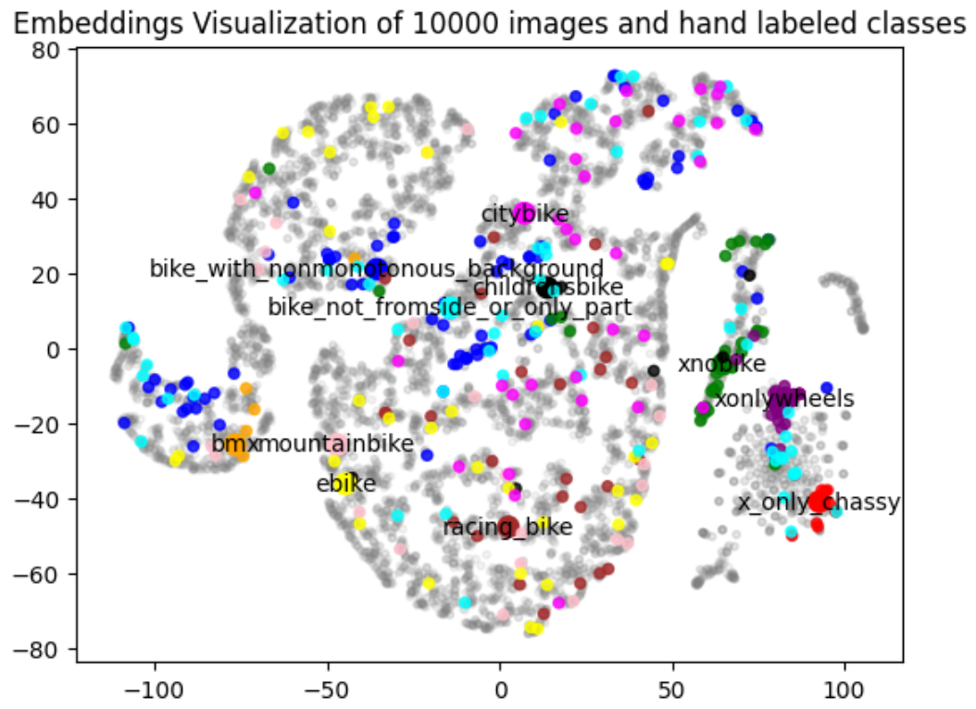
3.1. Filter out non-bicycle images
TSNE of ResNet with
classification head:
xnobike (green) is well separated
other classes (e.g. blue, cyan) are not well separated

Slide 11
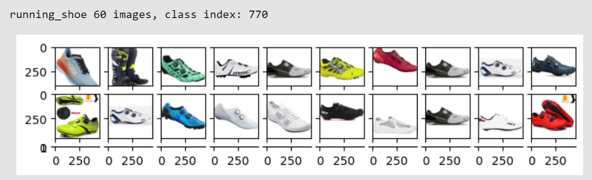
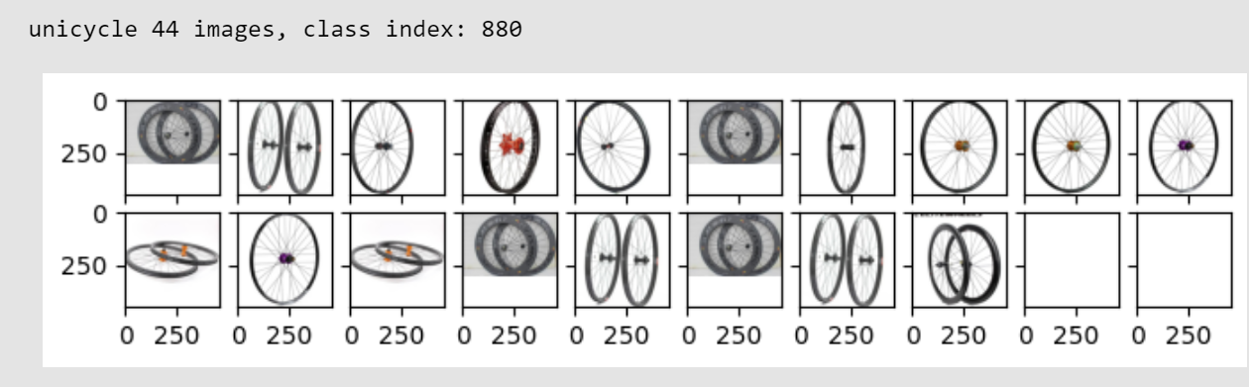
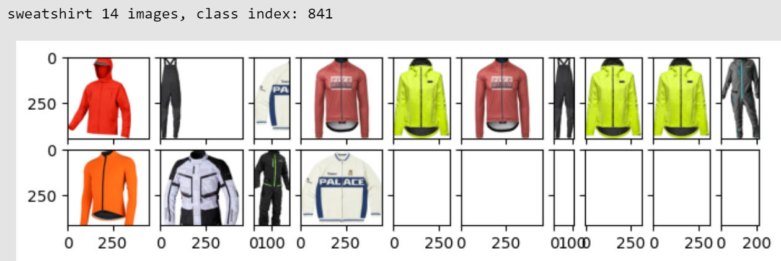
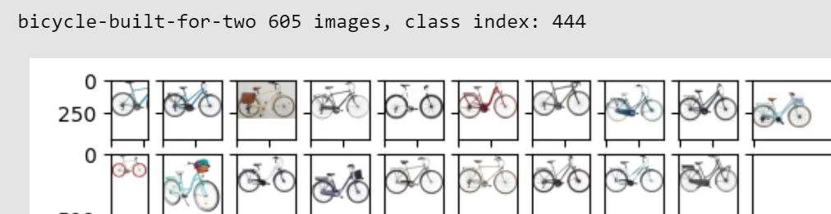
3.1. Filter out non-bicycle images
Examination of top-1 predictions of the classification head images shows many “top-1 classes” to be removable

Slide 12
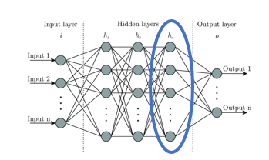
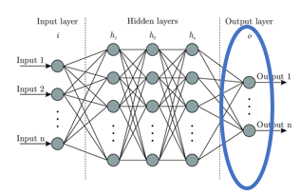
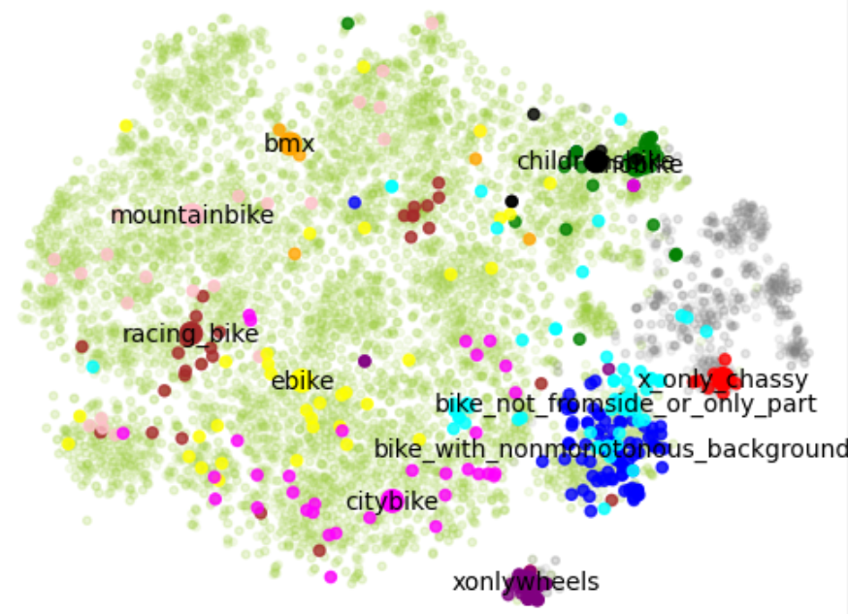
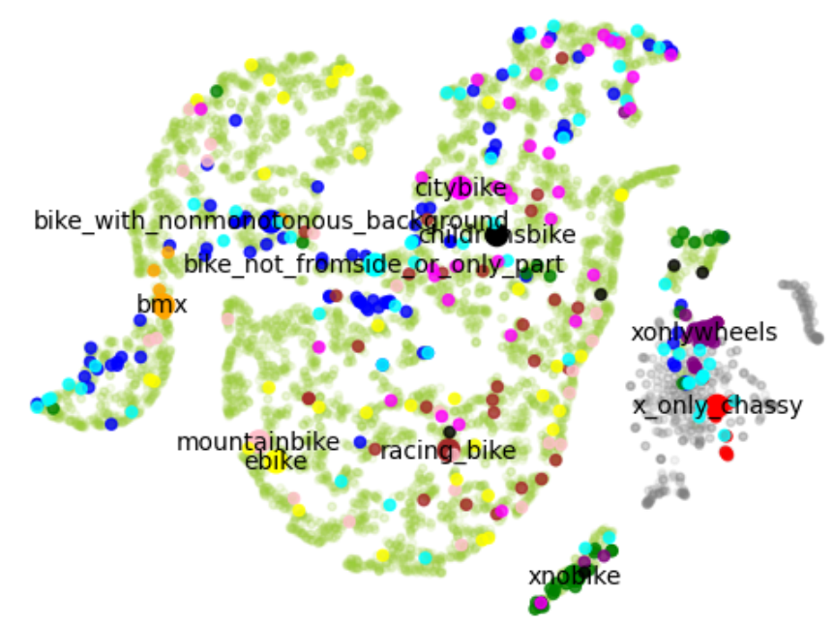
3.1. Filter out non-bicycle images
Embeddings after removal, 5200 images are removed, 54000 are kept
-> Still need to remove non-monotonous and xnobike

Slide 13
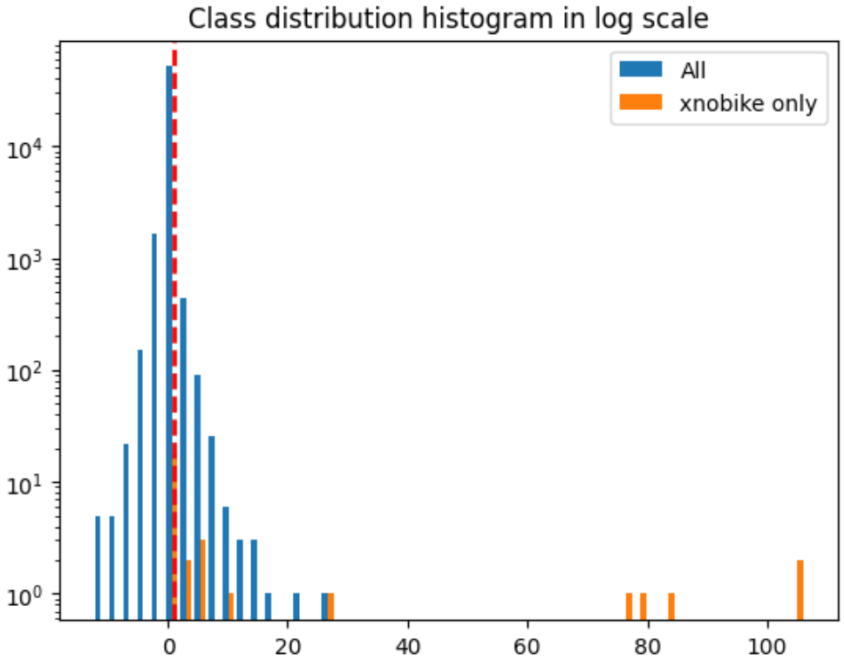
3.2. Remove non-monotonous and xnobike
Perform LDA on embeddings of hand-labeled images vs. all other images

Slide 14
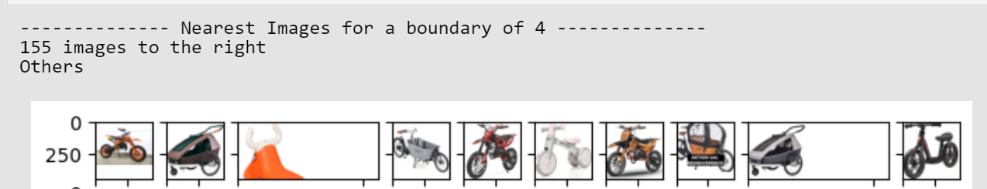
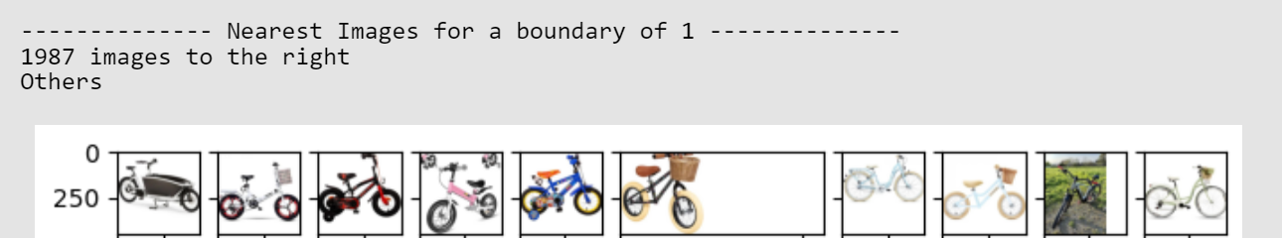
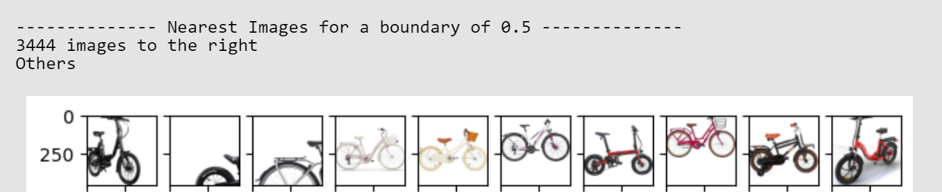
3.2. Remove non-monotonous and xnobike
2. Manually verify images kept for different thresholds
-> xnobike: Choose threshold 1, remove 1987 images, keep 52021
-> non-monotonous: threshold 0.97, remove 3194 images, keep 48825

Slide 15
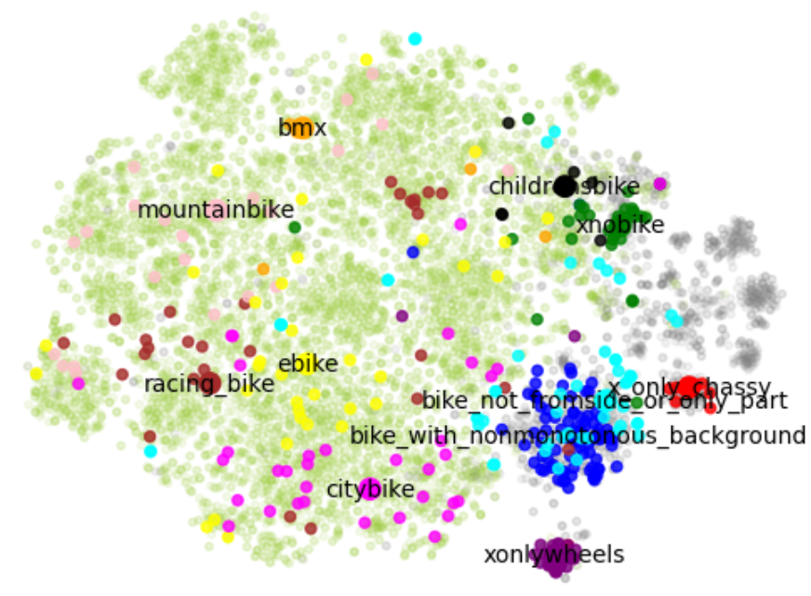
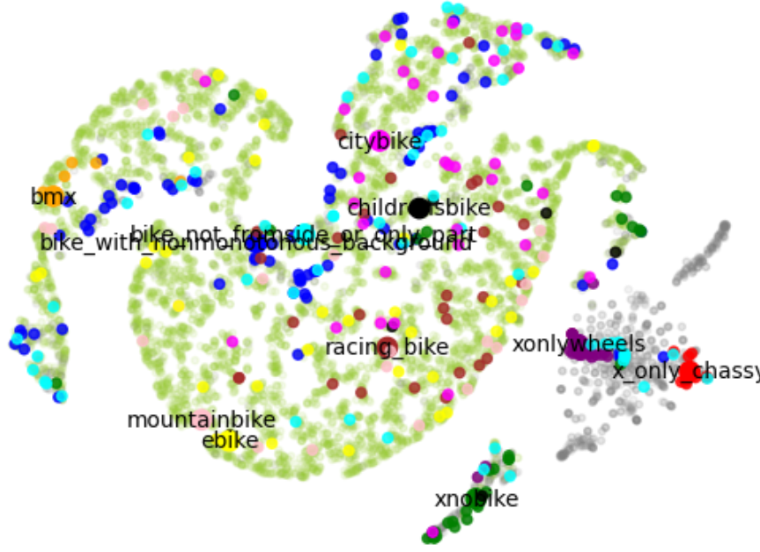
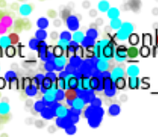

3.2. Remove non-monotonous and xnobike
Removal appears to be mostly successful

Slide 16
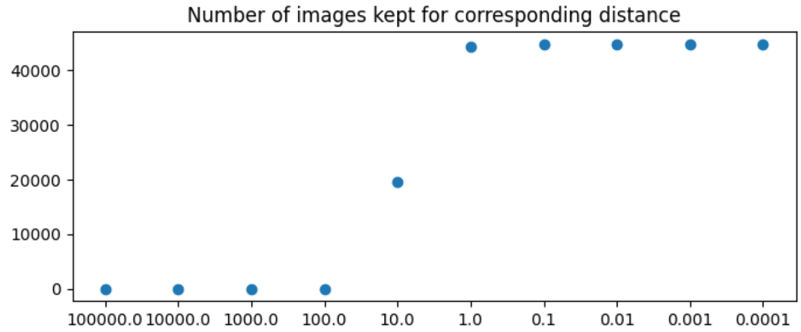
3.3. Remove duplicate images
Many duplicate images (Google)
Reuse embeddings, since they also represent “similarity” to a certain degree
Group images by Euclidean distance, groups of “distance x”
-> Choose threshold 1 , remove 3989 images, keep 44836

Slide 17
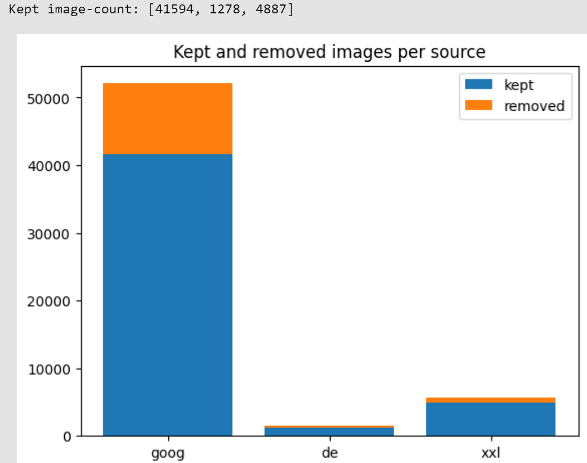
3.4. Is there bias in the images?
Many duplicate images (Google)

Slide 18
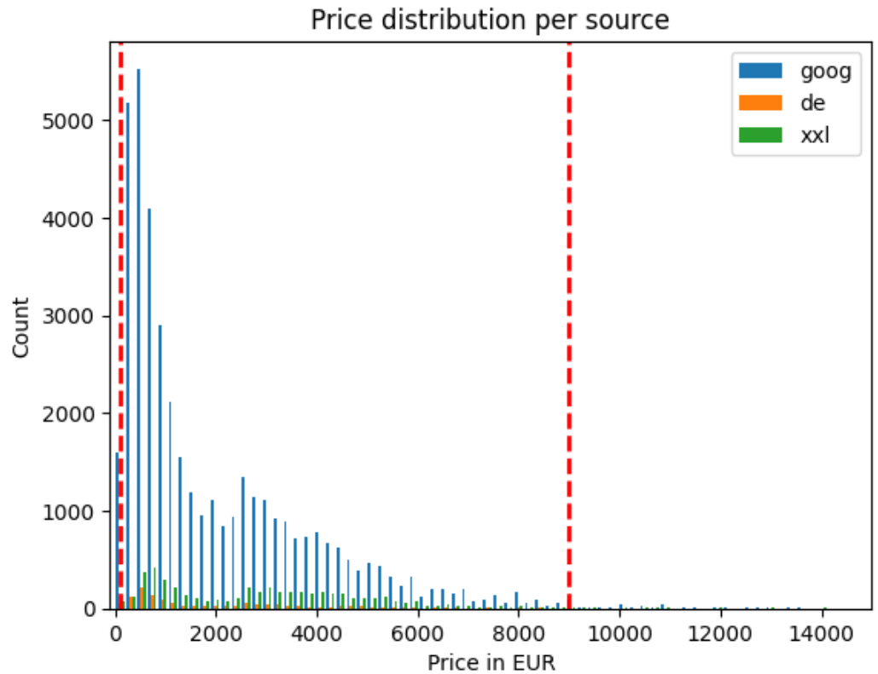
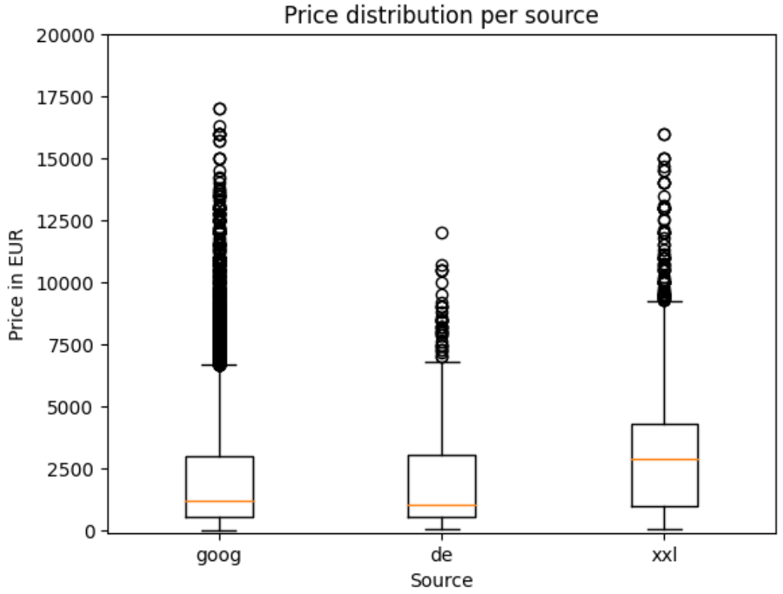
3.4. Is there bias in the images?
Price distribution per source
The bicycle-sellers tend to have higher priced bicycles
Generally, the number of images from Google outweighs this fact
Bicycles priced < 100 and > 10000 are removed

Slide 19
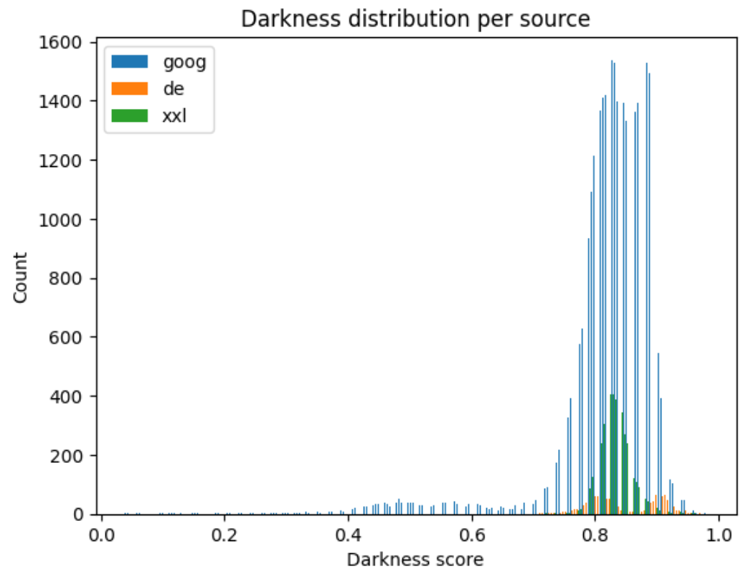
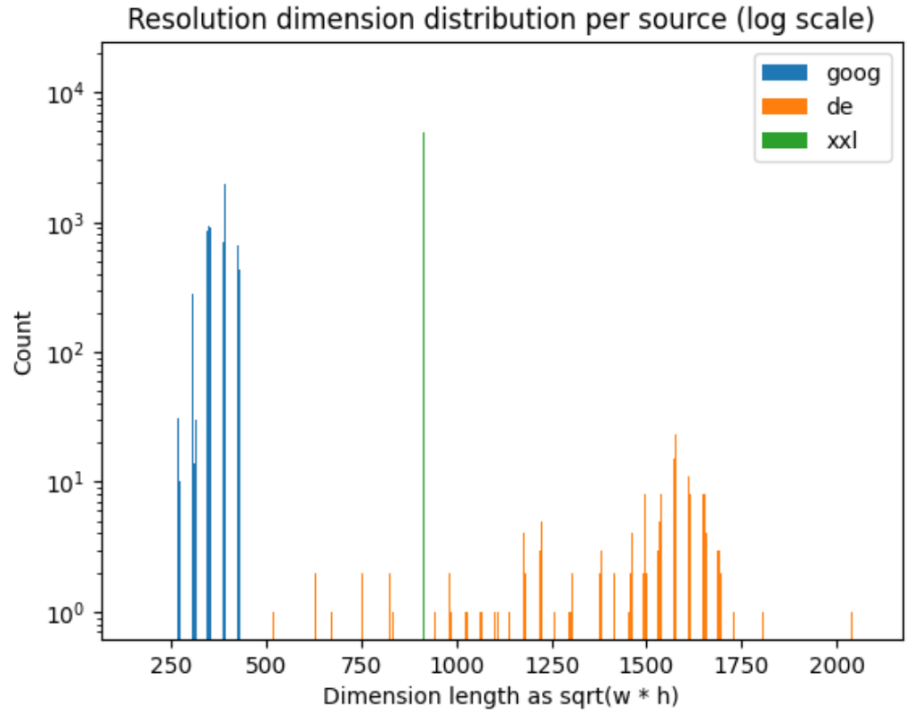
3.4. Is there bias in the images?
Darkness score is the
“average greyscale pixel value”
Fahrrad.de shows a deviating distribution but this is not further pursued

Slide 20
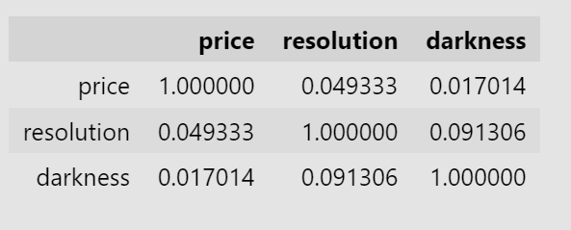
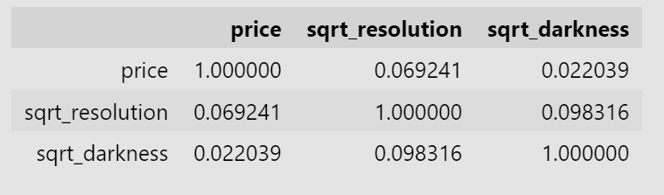
3.4. Is there bias in the images?
Linear correlation is calculated
As the price distribution looks similar to log-normal, this is explored
Price is most linearly correlated with the square root of resolution and darkness (0.022 and 0.069)
No large correlation can be determined

Slide 21
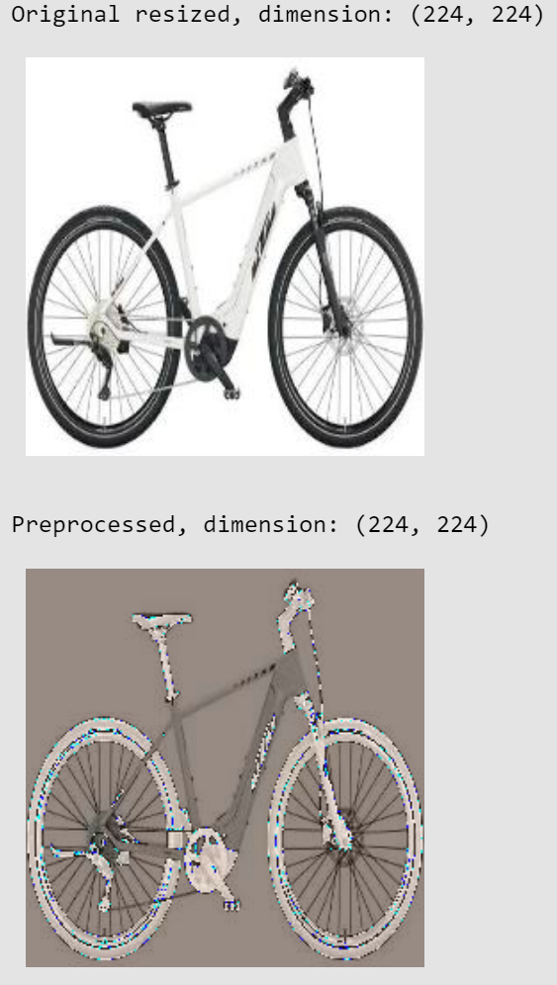
3.5. Preprocessing
Images are rescaled and preprocessing applied (for ResNet)
Cropping of images (Not part of the NB)
Visualization immediately before training

Slide 22
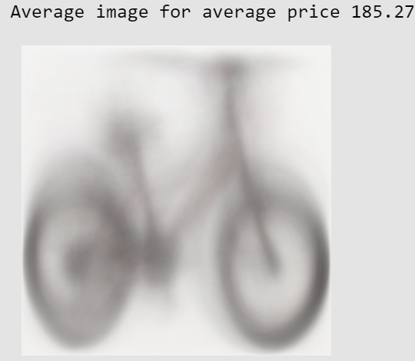
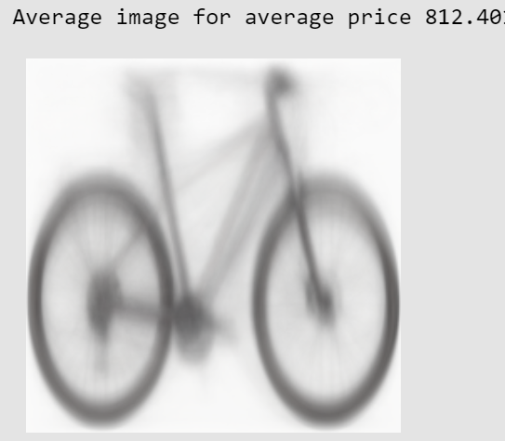
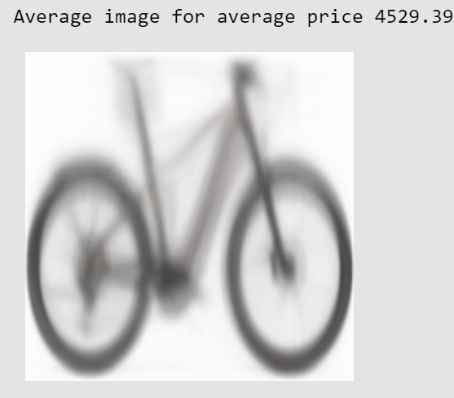
3.5. Mean Image
Compute the mean image for different price ranges
Bicycles are generally right facing
Most frequent shape seems to be “Mountainbike” (Non-horizontal mid-section)

Slide 23
3.5. Datasplit
Random Shuffle of all 3 sources,
Google
Fahrrad.de
Fahrrad-xxl.de
Train = 45000
Dev = 1000
Test = 1000 (Originally hp. optimization was intended)
Split is permanently saved and loaded via .json

Slide 24
4. Loss function
The algorithm will minimize the loss function
The choice of loss function has to match the problem to be solved
Otherwise unsatisfactory results will be obtained

Slide 25
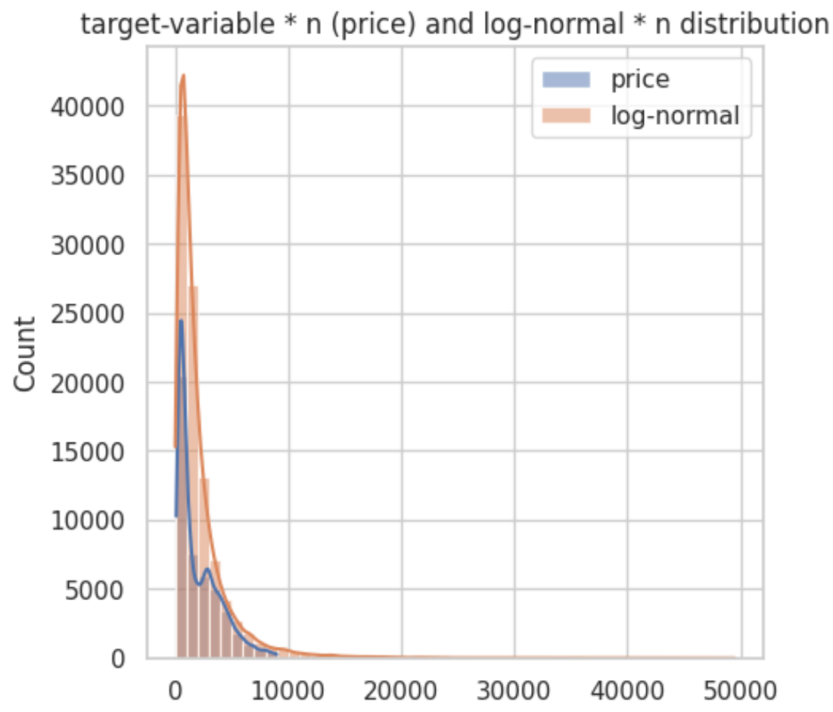
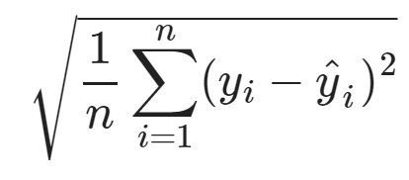
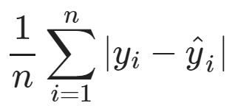
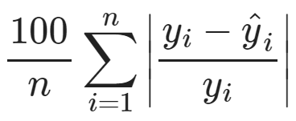
4. Loss function
RMSE:
MAE:
MAPE: Mean Absolute Percentage Error

Slide 26
4. Loss function
RMSE: The tail, high priced image, would be over-emphasized
MAPE: „Scaled MAE“ is more sensitive to small prices
y = 200, ŷ = 300, MAPE = 50%
y = 2000, ŷ = 2100, MAPE = 5%

Slide 27
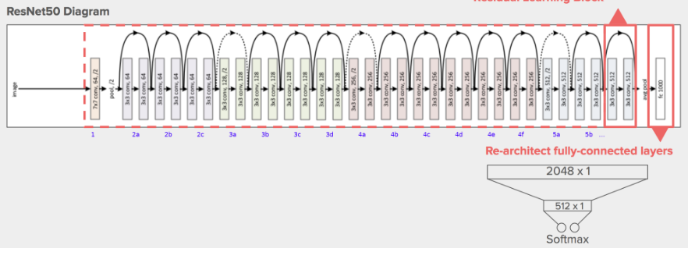
5. Model training: Baseline
The model used is a 50-block ResNet
Regression Head:
Hidden: 1024 Fully Connected Neurons
Output: 1 ReLu/Linear Neuron

Slide 28
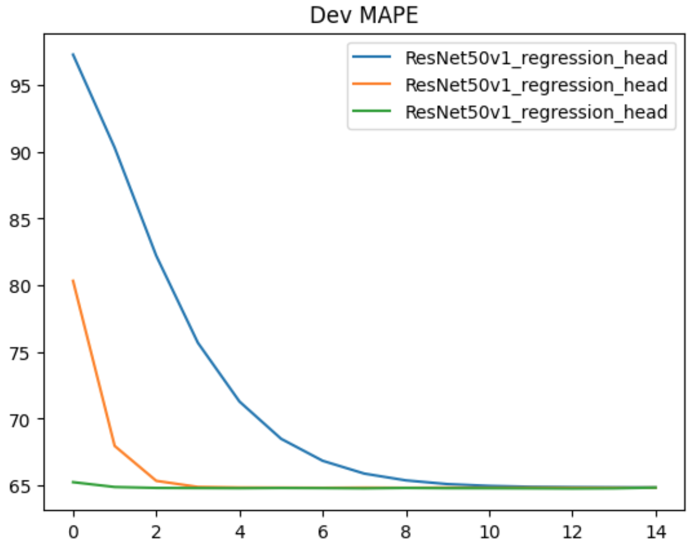
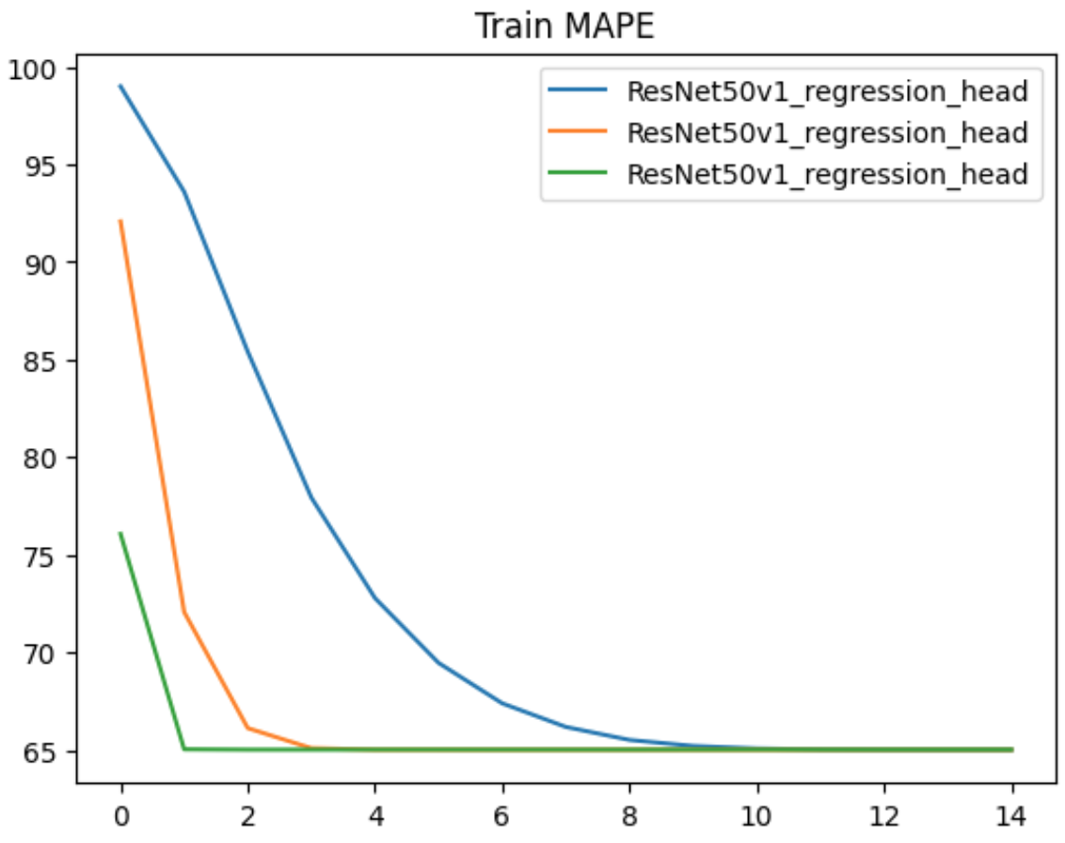
5. Model training: Baseline
bs: 32
lr: [
0.0001, 0.0003, 0.001
]
epochs: 15
The baseline model can not achieve good performance, MAPE = 65%
on average: 400€ or 1600€ for a 1000€ bicycle

Slide 29
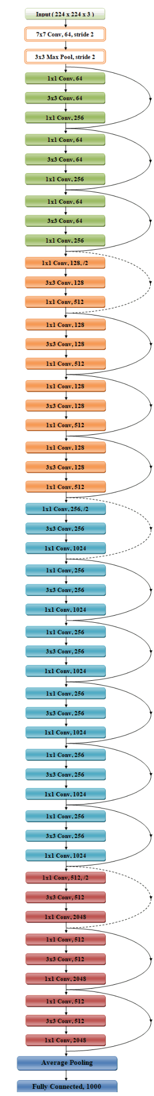
5. Model training: Conv5-Model
The model used is a 50-block ResNet
Retraining:
The last 6 of the total 53 convolutional layers
Regression Head:
Output: 1 ReLu/Linear Neuron

Slide 30
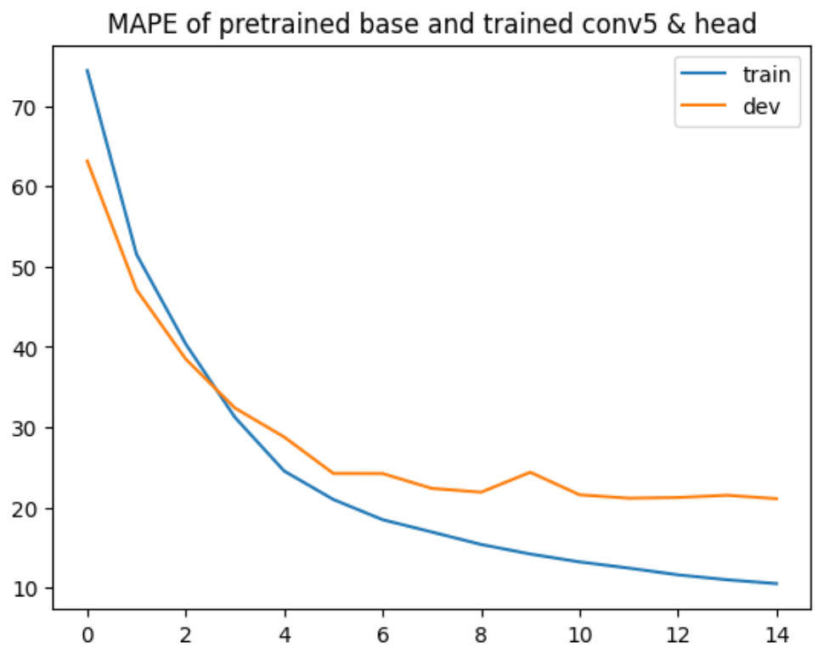
5. Model training: Conv5-Model
bs: 32
lr: 0.0001
epochs: 15
The performance is better, MAPE = 21%
Prediction on average: 800€ or 1200€ for a 1000€ bicycle
Improvements: Hyperparameter Tuning, simply using ResNet V2

Slide 31
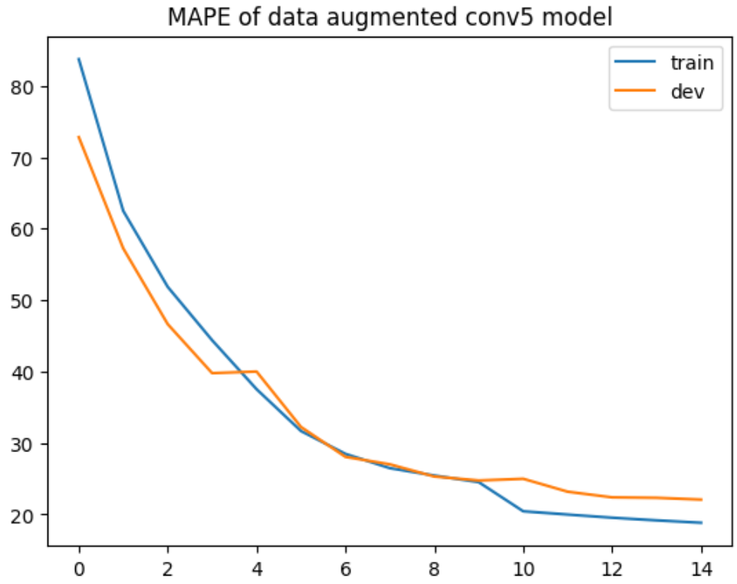
5. Model training: Robust Conv5-Model
The data is augmented by:
Flip
Rotation: 2.5 degrees
MAPE = 22%
Comparing MAPE
 | Baseline | Conv5 | Conv5 aug.
Dev | 65% | 21% | 22%
Aug. Test | - | 37.9% | 22.5%

Slide 32
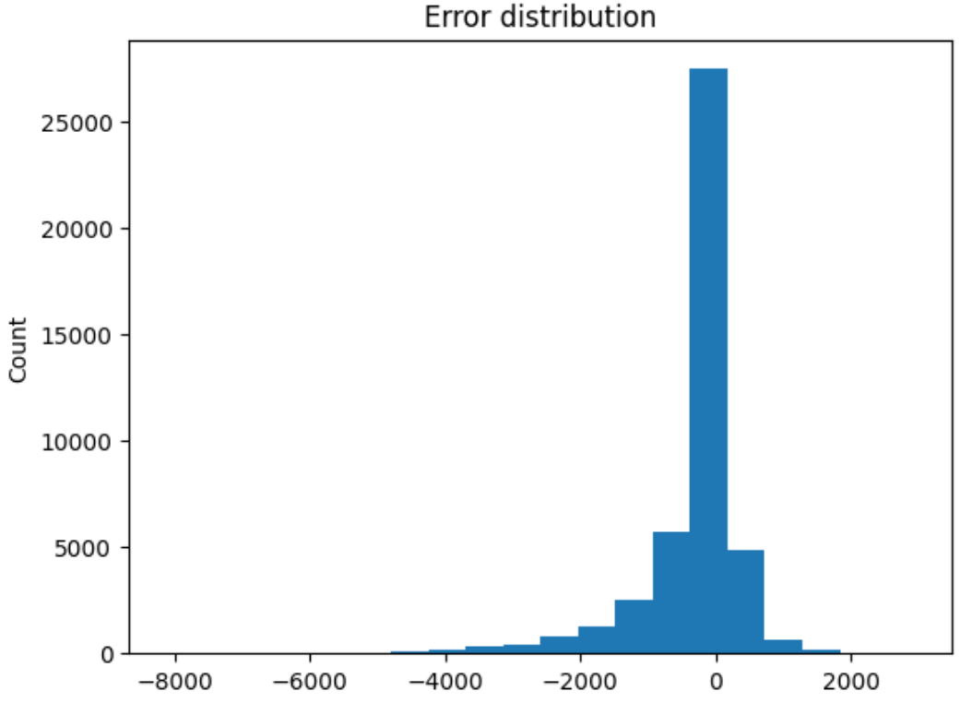
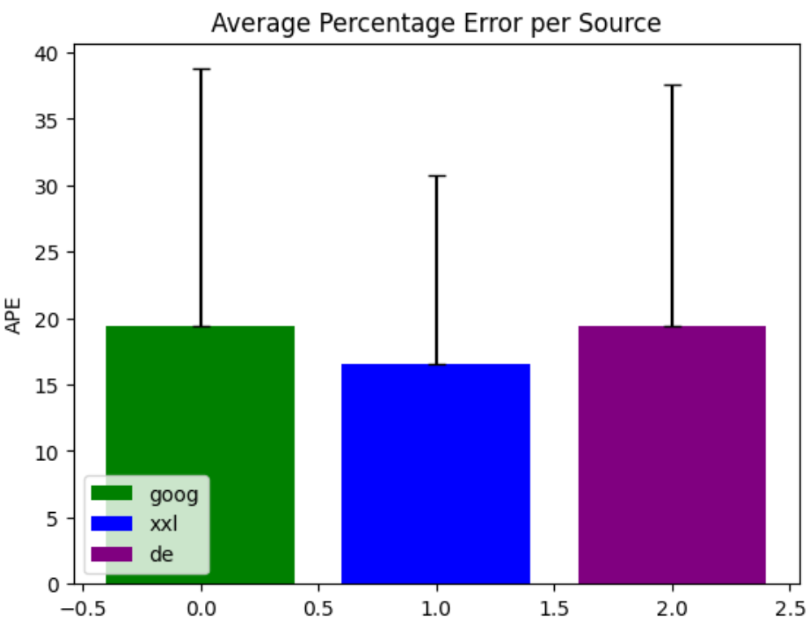
5. Recap: “Is there bias in the data?”
Error approximately normal distributed
No significant error difference between the sources

Slide 33
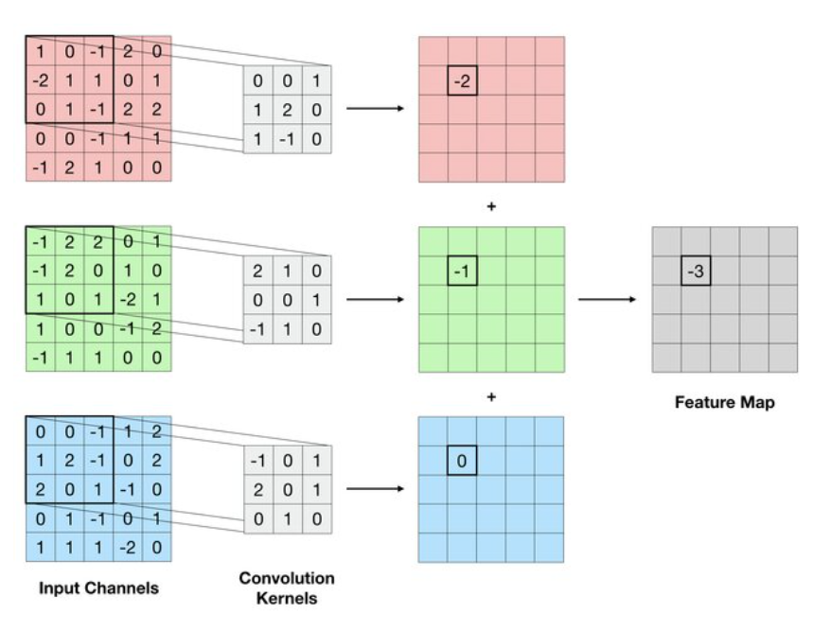
6. Visualization of activations
Gradient Cam:
Gradient of
1. the predicted output with respect to
2. the output-featuremap of
3. each convolutional layer

Slide 34
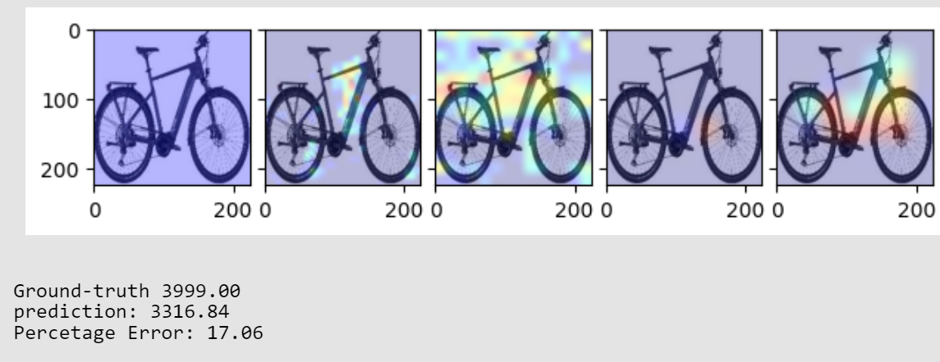
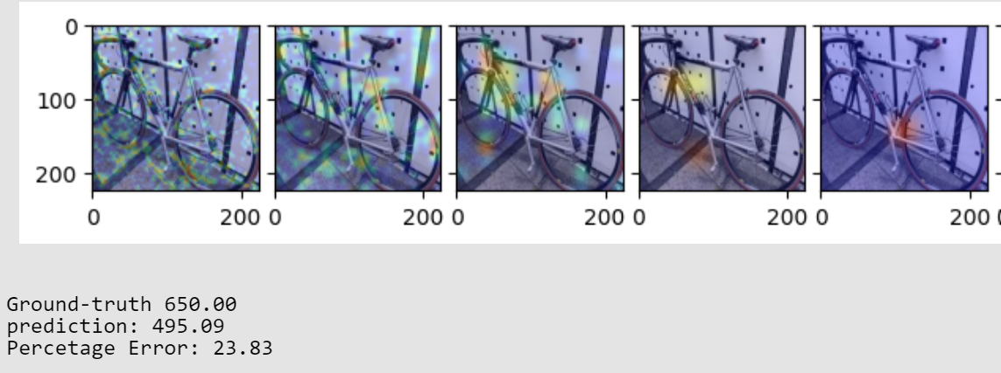
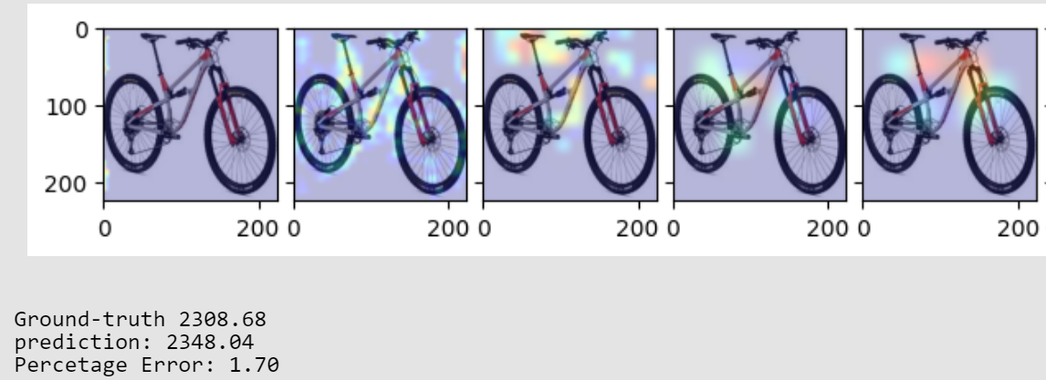
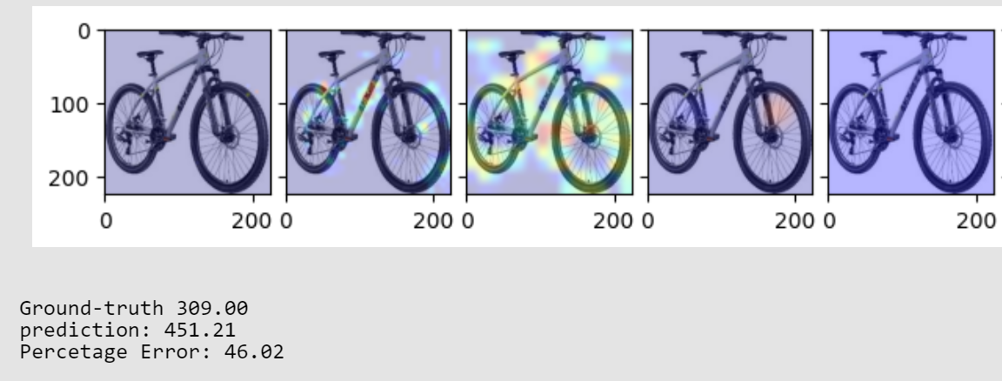


6. Visualization of activations
The algorithm generalizes:
unclean images
“non-sideview” images as well
Grad Cam is not 100% exact in locality (resolution is the feature map size of the respective Conv. Layer)

Slide 35




6. Visualization of activations
The algorithm picks up on some random white background pixelation
-> train-dev-test data-leakage
Only some images are affected
Only some layers are affected
The overall impact is not investigated

Slide 36
Thank you for your attention
Are there any questions, feedback or suggestions?

